Slide 1






Survival prediction using multi-omics data for Kidney Renal Clear Cell Carcinoma
Presented by:
Group-5
Name | Roll.no
Shrushti Dave | A012
Eashal Dbritto | A014
Sharvari Khopkar | A026
Yash Patil | A043
Prachee Shetye | A055
Mentored by:
Prof. Mangesh Kutekar

Slide 2
CONTENTS
INTRODUCTION | DATA PREPROCESSING
SURVIVAL ANALYSIS | METHODOLOGY
MULTI OMICS DATA | ANALYSIS
OBJECTIVES | RESULT
DATASET DESCRIPTION | CONCLUSION

Slide 3
INTRODUCTION
In recent years, a huge amount of biological data is being generated in healthcare.
This includes multiple types of biological data, often referred to as multi-omics data.
Such data helps us understand complex diseases like cancer more deeply, including kidney cell carcinoma (RCC), the most common type of kidney cancer, which originates in the lining of the kidney tubules.
One important task is survival prediction, which estimates how long a patient might survive.
This study focuses on comparing different statistical and machine learning methods for survival prediction.
It also checks whether using multi-omics data improves accuracy compared to using only clinical data.

Slide 4
SURVIVAL ANALYSIS
Survival analysis studies time-to-event data, i.e., how long it takes for an event to occur
It can handle censored data, where the exact event time is not fully known
It focuses on survival probability over time and the risk of the event occurring
It also examines how different factors (covariates) affect survival
Common methods include Kaplan–Meier and Cox proportional hazard
model.

Slide 5
MULTI-OMICS DATA
Multi-omics data means combining different types of biological information from the same patient
It includes data like genes, RNA, proteins, and metabolites
These datasets are high-dimensional, meaning they contain thousands of variables but relatively fewer samples
This makes the data complex and challenging to analyze
By combining different data types, we get a more complete understanding of diseases
It is widely used to improve prediction, diagnosis, and treatment decisions

Slide 6
OBJECTIVES
To evaluate and compare different statistical and machine learning methods for survival prediction.
To analyze the effectiveness of these methods when applied to multi-omics data.
To study whether incorporating multi-omics data improves prediction accuracy compared with using only clinical data.
To examine the impact of considering group structure of omics data (such as clinical, RNA, mutation, etc.) in model building.
To assess model performance using appropriate metrics like C-index.
To identify which method provides the best predictive performance for survival outcomes.

Slide 7
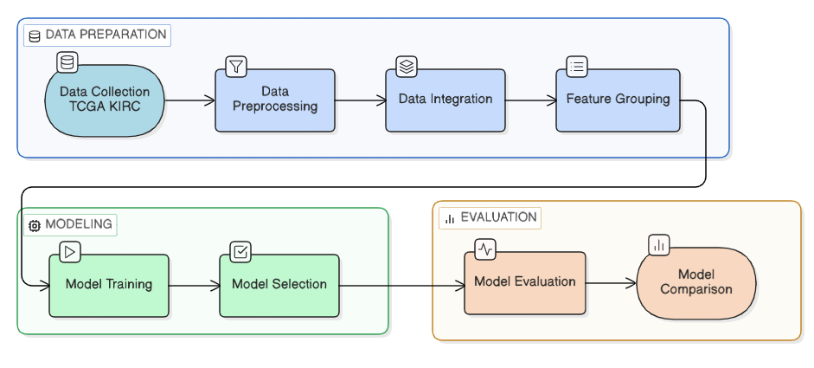
METHODOLOGY

Slide 8
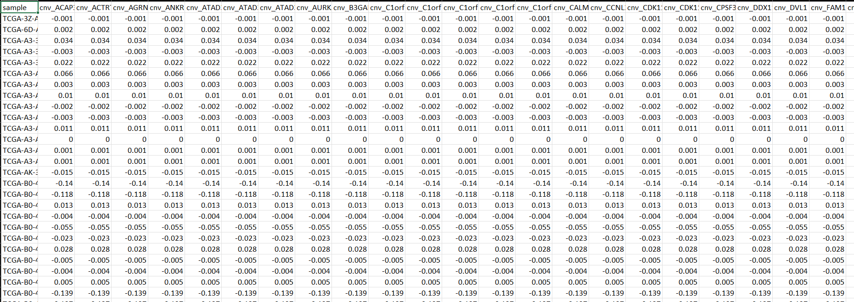
DATA COLLECTION
Data collected from TCGA (KIRC dataset)
Includes clinical and omics data
Omics data consists of:
mRNA (gene expression)
CNV (Copy Number Variation)
Mutation data
miRNA data
Each omics dataset contains a large number of variables
Data merged using common sample IDs
DATA SET | SAMPLES | VARIABLES
Clinical | 193 | 17
mRNA | 193 | 20530
CNV | 193 | 24776
Mutation | 193 | 40543
miRNA | 193 | 2048

Slide 9
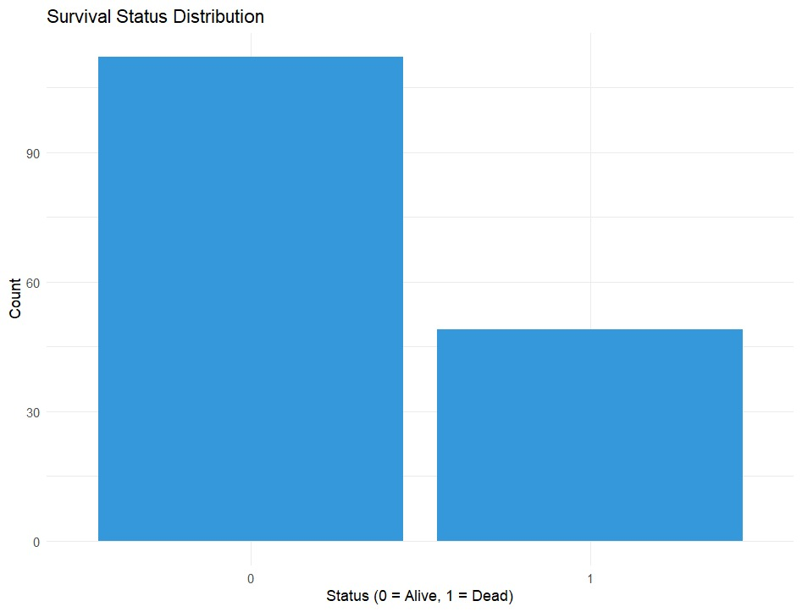
DATA PREPROCESSSING
Loading multiple datasets: clinical, mRNA, CNV, mutation, miRNA.
Processing clinical variables: -
- Gender encoded as binary.
- Tumor stage converted to numeric levels.
- Removal of missing values using complete
case filtering.
Replacement of remaining missing values with 0.
Removal of invalid observations (for example, OS.time ≤ 0).
Merging all datasets using common sample ID (inner join)

Slide 10
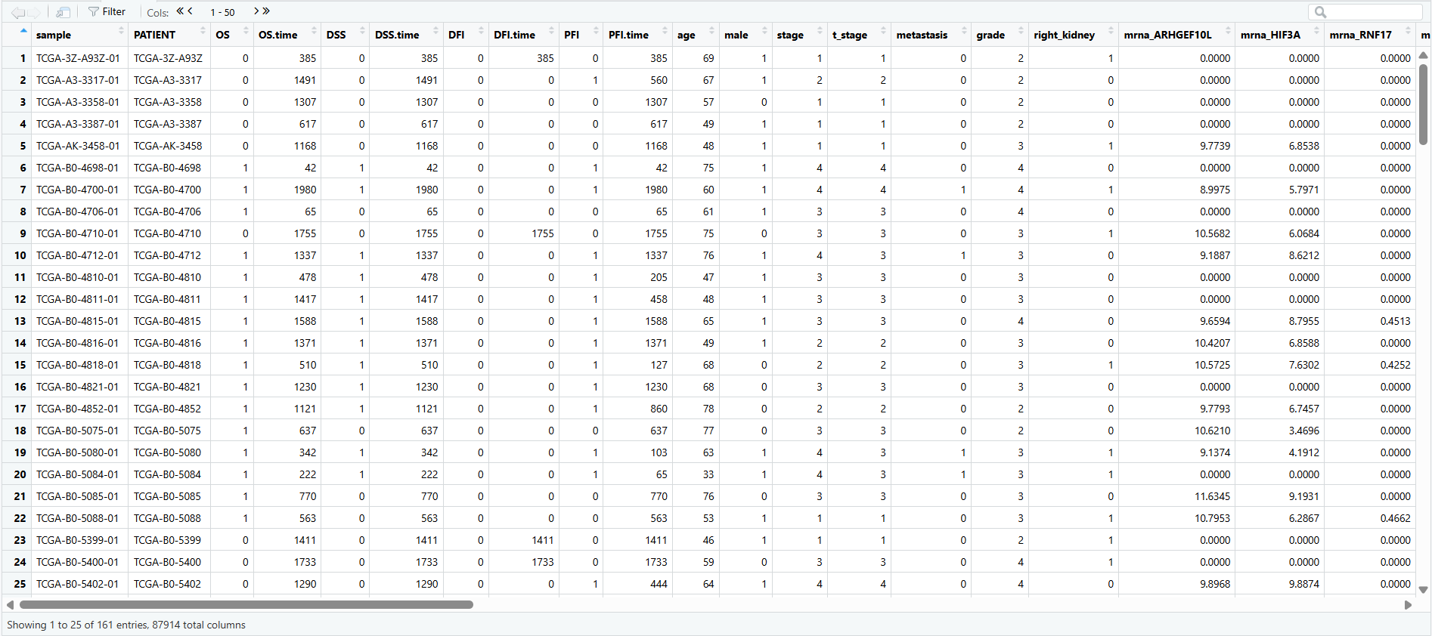
DATASET

Slide 11
DATA INTEGRATION
Data integration is the process of combining data from different sources into one unified dataset.
In multi-source studies, data may come from various domains like clinical, genomic, and other biological layers.
A common identifier, such as a patient or sample ID, is used to link data across sources.
This ensures that all information refers to the same entity and improves data consistency.
During integration, issues like missing values and inconsistencies are identified and addressed.
The integrated dataset offers a complete view by capturing information from multiple perspectives. This unified data is then used for further analysis and model building.

Slide 12
FEATURE GROUPING
Feature grouping organizes variables into meaningful groups based on their source or characteristics
In multi-omics data, features are grouped into clinical and different omics types (mRNA, CNV, mutation, miRNA)
It helps capture relationships and structure within the data
Allows models to treat related variables as a single unit
Improves model performance and interpretability
Especially useful for high-dimensional datasets
Clinical
mRNA
CNV
Mutation
miRna
Features

Slide 13


MODEL SELECTION
Reference Models
Kaplan Meiere
Cox Model
Estimates survival probability over time
Handles censored data
Produces step-wise survival curve
Used as baseline model
Does not use predictor variables
Models relationship between survival and covariates
Based on hazard function
Assumes proportional hazards
Provides interpretable coefficients
• di​: number of events (deaths)
• ni​: number of individuals at risk
Survival probability is calculated at each event time and multiplied cumulatively
• h0(t): baseline hazard
• β: coefficients
• X: predictor variables
Measures effect of variables on survival risk

Slide 14


MODEL SELECTION
Penalized Regression and
Boosting Models
Cox Lasso
Cox Boost
Penalized Cox model with L1 regularization
Shrinks coefficients → automatic feature selection
Reduces overfitting
Suitable for high-dimensional data
Boosting-based extension of Cox model
Builds model iteratively (step-by-step)
Updates coefficients using learning rate
Performs automatic feature selection
Suitable for high-dimensional data
β^m: coefficients at iteration m
ν : learning rate
Δβj : update for selected variable
Iteratively improves model using boosting
L(β): partial likelihood
λ: regularization parameter
βj​: coefficients

Slide 15


MODEL SELECTION
Tree Based Models
Random Forest
Block Forest
An ensemble learning method based on multiple decision trees
Uses bootstrap sampling (bagging) to create different datasets
Each tree is built using a random subset of features
Captures non-linear relationships in data
Reduces overfitting by averaging multiple trees
Works well with high-dimensional and complex data
• Extension of Random Forest designed for grouped data.
• Uses block (group) structure of variables during tree construction
• Splitting is done by selecting variables from specific groups
• Ensures that important groups (like clinical data) are not ignored
• Improves prediction performance when data has natural grouping
• Suitable for multi-omics datasets
• Trees are built considering grouped variables
• B: number of trees
Incorporates group structure into Random Forest for better prediction
• B: number of trees
• Tb(x): prediction from the bth tree
Final prediction is obtained by averaging predictions from all trees

Slide 16
MODEL TRAINING
Model training involves learning patterns from the available dataset
The dataset is divided into training and testing sets
Models are trained using the training data
Cross-validation is applied to improve model stability and reliability
Helps in reducing overfitting and improving generalization
Different models are trained under the same conditions for fair comparison
The trained models are then used to make predictions on unseen data
TRAIN-TEST
SPLIT
TRAINING
DATA
CROSS
VALIDATION
MODEL
TRAINING
TRAINED
MODEL
DATASET

Slide 17
MODEL EVALUATION
Model evaluation is used to check how well the trained models perform
It is done on unseen (test) data to see how the model works in real situations
Helps us understand whether the model can generalize well to new data
Cross-validation is used to make the results more reliable and stable
C-index (Concordance Index)
Shows how well the model can rank patients based on risk
It checks if patients with higher predicted risk actually experience the event earlier
Values range from 0.5 (random) to 1 (perfect prediction)
Higher value means better performance

Slide 18
MODEL COMPARISON
Model comparison is used to see how different models perform and compare them with each other
All models are evaluated using the same metrics to ensure a fair comparison
This helps us clearly identify which model performs better
Models are compared using:
C-index → higher value means better ranking ability
This comparison helps in understanding the strengths and limitations of each model
Based on the results, the best-performing model is selected

Slide 19
ANALYSIS
Integrated dataset description
Multiple datasets (clinical, mRNA, CNV, mutation, miRNA) were integrated
Data was merged using inner join to retain common patients
Ensured consistency and removed missing patient records
Dataset Summary:
161 patients, 49 events (30.4%)(Deaths)
87,914 variables (high-dimensional data)
Survival defined using:
OS.time (time-to-event)
OS (event indicator)
Reduced features from ~87,000 to 1,707 for modeling
Clinical (17) – basic patient information
mRNA (20,530) – gene expression
CNV (24,776) – copy number variation
Mutation (40,543) – mutation features
miRNA (2,048) – expression features

Slide 20
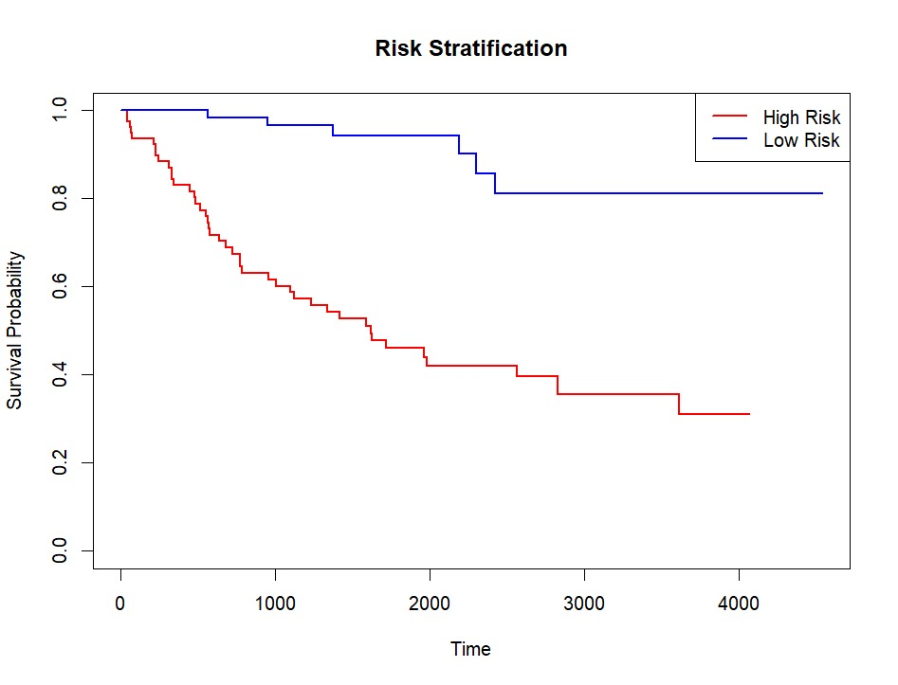
ANALYSIS
Model Approach
Combination of statistical and machine learning models for survival analysis
Kaplan–Meier and Cox model applied on clinical data for baseline understanding
Advanced models (Lasso Cox, CoxBoost, Random Forest, Block Forest) applied on multi-omics data
Models are chosen for their ability to handle high-dimensional data
Kaplan-Meier Graph

Slide 21
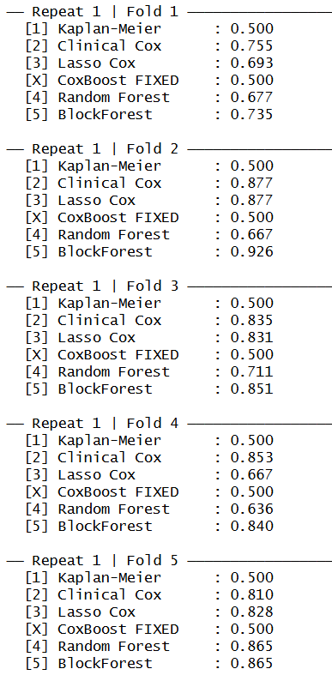
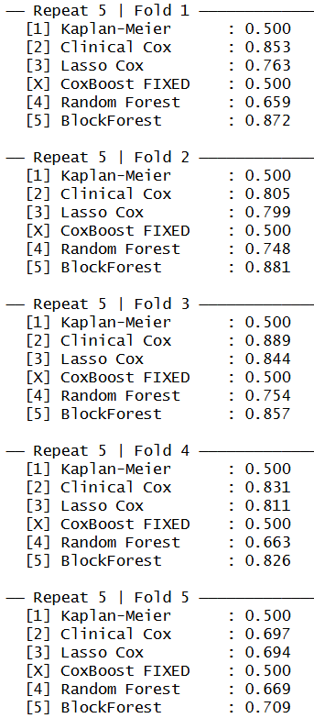
ANALYSIS
5 Cross-Validation
A 5-fold cross-validation approach was used to evaluate model performance
The dataset was randomly divided into 5 equal subsets (folds)
In each iteration:
4 folds were used for training
1 fold was used for testing
This process was repeated 5 times, ensuring each fold was used once as test data

Slide 22
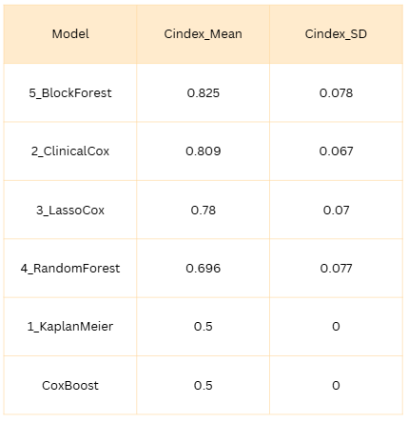
ANALYSIS
Model Evaluation
Performance measured using C-index (mean ± SD)
Evaluated with 5-fold cross-validation
Results:
BlockForest: 0.825 ± 0.078 → Highest accuracy, slightly variable
Clinical Cox: 0.809 ± 0.067 → Slightly lower accuracy, more stable
Lasso Cox: 0.78 ± 0.070 → Balanced performance
Random Forest: 0.696 ± 0.077 → Lower accuracy, less stable
Kaplan-Meier & CoxBoost: 0.50 ± 0.00 → Baseline
Conclusion:
Best model = high mean + low SD
BlockForest → best accuracy
Clinical Cox → best stability
Trade-off between performance and consistency

Slide 23
ANALYSIS
Model Performance Comparison
Model performance was compared using the mean C-index computed across 5 cross-validation folds
Model | Mean C-index
Block Forest | 0.825
Clinical Cox | 0.809
Lasso Cox | 0.780
Random Forest | 0.696
Kaplan-Meier/CoxBoost | 0.500
Block Forest achieved the highest predictive performance
Clinical Cox model also performed strongly, highlighting importance of clinical variables
Lasso Cox showed moderate performance
Random Forest performed comparatively lower
Kaplan–Meier/CoxBoost serves as baseline (no predictors)

Slide 24
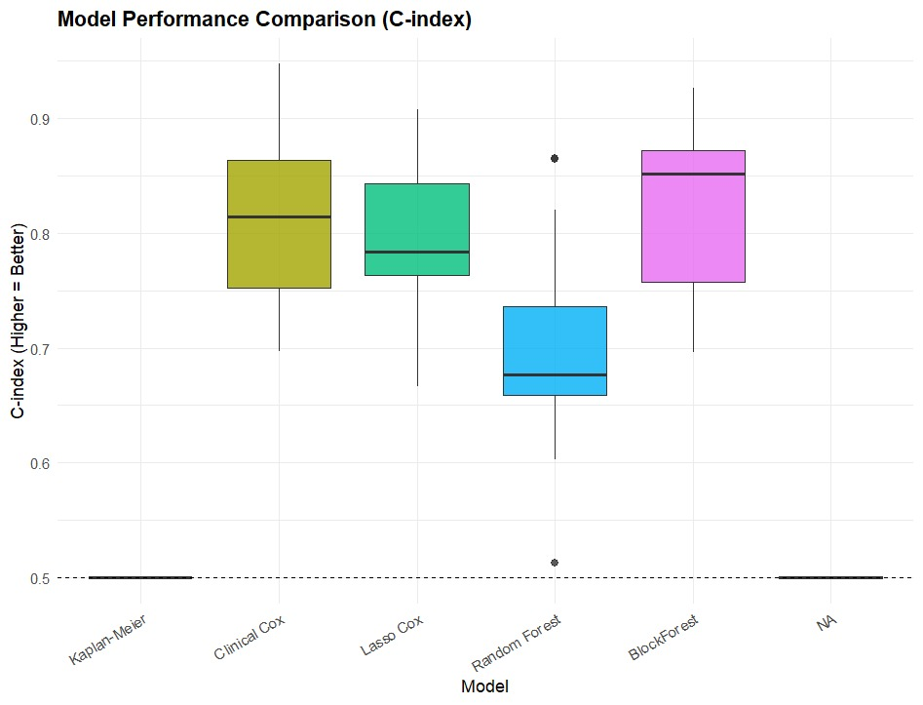
ANALYSIS
Model Stability
Stability assessed using C-index across 5-fold cross-validation
Boxplot used to visualize:
- Median performance
- Variability across folds
- Presence of outliers
Interpretation:
Higher median → better performance
Smaller spread → more stable model
Observations
Block Forest: Highest median with good stability
Clinical Cox: Consistent and stable performance

Slide 25
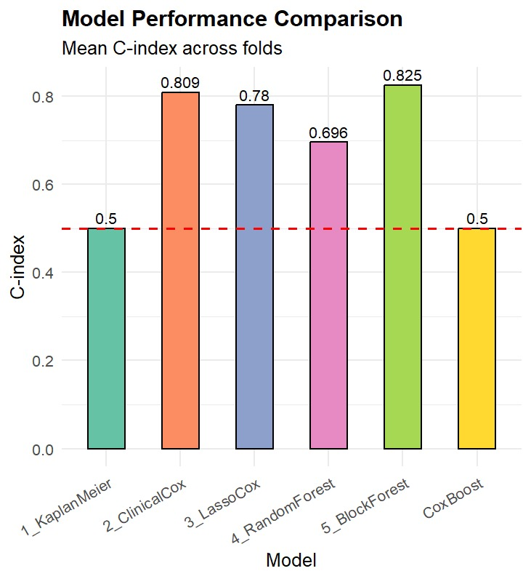
RESULTS
Block Forest achieved the best performance
Mean C-index = 0.825
This indicates:
Highest predictive accuracy
Good stability across cross-validation folds
Clinical Cox also performed strongly (C-index = 0.809)
Highlights importance of clinical variables
Block Forest is the best model for survival prediction using multi-omics data.

Slide 26
CONCLUSION
Block Forest achieved the best performance (C-index = 0.825), showing strong predictive ability
Models incorporating group structure of multi-omics data performed better than naive models
However, the improvement using multi-omics data over clinical data was only marginal
Clinical Cox model also showed strong performance, highlighting the importance of clinical variables
While multi-omics data adds value, it also increases computational complexity
Overall, structured models like Block Forest are effective, but their practical usefulness should be carefully evaluated.

Slide 27
Limitations and Future Scope
LIMITATIONS
High-dimensional data with small sample size may affect stability
Evaluation is limited to C-index
Limited hyperparameter tuning
Slight improvement using multi-omics data
High computational complexity
No external validation
FUTURE SCOPE
Use additional metrics like Brier Score
Improve model with proper tuning
Apply feature selection / dimensionality reduction
Explore advanced models (e.g., deep learning)
Validate on external datasets
Improve computational efficiency

Slide 28

Reference

Slide 29
Thank you
Any Questions..?

